Slide 1
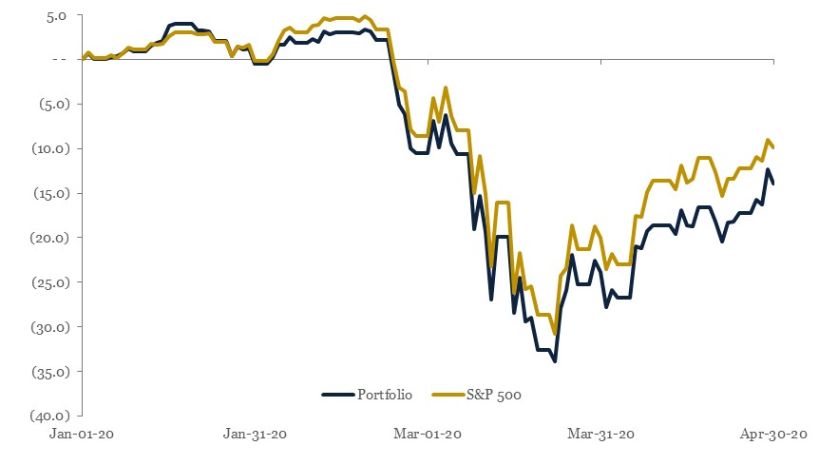
Portfolio Returns
(9.9%)
(13.9%)

Slide 2
Portfolio Composition

Slide 3

The Goldman Sachs Group, Inc.
NYSE: GS
Recommendation: BUY
Brian Kelley

Slide 4
Executive Summary
Industry Overview
Overview of post-crisis regulation, implementation, and forward-looking predictions
Trend towards cost-cutting, electronification, and automation
Covid-19 impact on macroeconomic outlook and interest rates
Company Overview
Goldman’s revenue streams primarily come from investment banking, trading, and consumer banking
Post-crisis strategy has largely focused on trimming market-based risk and focusing on investment banking
Industry leading investment banking deal flow and trading activities
Investment Thesis
Goldman correct mix of business units market outlook – investment bank as a macro hedge
Challenger position as a consumer bank
CECL Implementation has lead to mispricing and pro-cyclical earnings
Valuation
Base case valuation, with a price target of $201.18, represents a 5.9% upside to current trading price of $190.03⁽¹⁾.
Upside case – price target of $277.01 – 45.8% upside
Downside case – price target of $165.94 – 12.7% downside
Risks
Fallout from Covid-19 may last significantly longer than expected
A prolonged period of deflation could erode returns from the loan portfolio by flattening the yield curve
Consumer woes post Covid-19 harm growth in that sector

Slide 5
Industry Overview
Trends
Post-Crisis Regulation
Regulation has been incrementally written and implemented since the global financial crisis, such as Dodd-Frank, Basel III, and more
The industry has become incredibly conservative in handling RWAs, and most banks hold significant excess reserves
Cutting costs through automation and headcount reductions has also been a major theme for large-cap banks
  Electronic trading and portfolio trading have vastly reduced headcount and generally increased efficiency and trading costs
Risk management is seen as increasingly important
Regime | Effects
Dodd-Frank | Accounting reforms, mortgage reforms, and the Volcker rule
Basel III | Minimum Capital Requirements of 4.5% CET1, 1.5% AT1 Minimum SIFI Leverage Ratio of 6% Minimum Liquidity Ratio of 100%
CECL | Expected losses over the life of a loan must be incurred immediately rather than absorbed gradually
Industry Net Interest Margin
Quarterly GDP Estimates
Notes:
JPM excess reserves – 45%
Regulators – Fed (BHCs), Office of the Comptroller of Currency, FDIC, State Regulators, FHFA
https://americanstaffing.net/staffing-research-data/asa-data-dashboard/gdp-quarterly-projections/

Slide 6
Company Overview
Business Profile
YTD League Tables
Goldman Sachs is a systemically important financial institution with roughly $1 trillion in assets and $10 billion in revenues
It operates in 30 different countries and has an employee headcount of almost 40,000
It has a leading presence in investment banking activities as well as maintaining business lines in commercial banking, asset management, wealth management and consumer banking
Recent company trends include opening a consumer bank, hiring tech talent, and shifting the focus from trading to investment banking under new CEO David Solomon
League Table | Rank | Mkt Share | No. Deals | Value ($mm)
M&A | 1 | 29.8% | 84 | $232,249.8
Equity | 2 | 9.6% | 95 | $15,801.0
Debt | 5 | 4.0% | 380 | $126,912.7
Org Chart
Revenue by Segment ($bn)
Goldman Sachs
Investment Banking
Financial Advisory
Underwriting
Institutional Client Services
FICC Execution
Equities
Investing and Lending
Investment Management
Management and Other Fees
Transaction Revenues
Notes:
Marcus expenditures – startup acquisitions, cloud storage space, tech talent hiring. Launched without a collection team, since hired one

Slide 7
Stock Chart

Slide 8
Investment Thesis
Goldman’s is well-positioned for a potentially prolonged period of economic pain and volatility due to a natural hedge formed by its investment banking, trading, and asset management arms. These are outsized in comparison to other large-cap US banks. Goldman also holds industry-leading positions in these business lines.
1
2
Goldman’s new consumer banking unit, Marcus, is poised for explosive growth coming out of an economic downturn. One source of mispricing in the stock is general pessimism about Marcus stemming from the $1.3bn it has lost since 2016. Higher savings rates and an improved staff should do away with these concerns.
3
CECL, a new banking regulation currently being phased in, is not well understood. Price action would suggest that market participants do not understand the new regime – Provision for Credit Losses and how that feeds into Allowance for Loan Losses. Banks began reporting under CECL during Q1.

Slide 9
1. Goldman’s mix of business units is attractive
Efficiency and Excellence
Selected Market-Facing Businesses
GS has been able to steadily reduce operating expenses without reducing headcount significantly, as other banks have
Electronic trading has been vastly improved and is second-best among investment banks following a push for tech talent
  Equities almost fully electronic, liquid corporate bonds growing quickly
  Industry pioneer in Fixed Income portfolio trades
GS has an efficiency ratio of 74% - far exceeding the industry average of just 61.1% and trailing only Morgan Stanley
Investment Management and Investment Banking
Effects of Volume, Volatility, and Liquidity on Trading
Investment management can easily reap fees in volatile markets by actively trading in and out of specific assets
Investment banking fees will typically drop slightly but will be supported by restructuring, advisory, and other activity during the recovery
Goldman (as well as the rest of the banks) is extremely well-prepared for any further deterioration in economic activity due to harsh post-crisis regulation. It has no need to cut its dividend
Resultantly, the bank is well-positioned for another downturn if one is coming
Global Markets revenue makes up 36% of Goldman’s net revenues, down from 44% in 2014
Greater volatility allows market makers to charge higher bid-ask spreads, giving traders opportunities to profit as the “true” price is less known
High volatility typically increases volumes, which in turn increase total revenue from the electronic trading of equities
Technical factors increase the value of liquidity, which Goldman can readily provide with its systemically large balance sheet
These factors form a natural hedge against market turmoil

Slide 10
1b. Portfolio Exposure
Investment Club Portfolio Weightings
Implications
As it currently stands, 26% of the Investment Club portfolio is in Tech, Media, and Telecom
The club’s only financials holdings are through passive indices
Adding GS to the portfolio should probably add diversification benefits as well as providing exposure to
NDIC Financials Exposure
Index | Financials Index Weight | NDIC Portfolio Weight | NDIC Financials Exposure
S&P 500 | 12.94% | 25.47% | 3.30%
Russell 2000 | 17.59% | 15.11% | 2.66%

Slide 11
2. Marcus is poised for explosive growth
Marcus Summarized
Marcus Deposits
Marcus was opened in 2016 as part of Goldman’s push into consumer banking, and is a source of market mispricing
Currently the platform offers savings accounts insured by the FDIC and no fee, fixed-rate personal loans up to $40,000
Marcus currently resembles a challenger bank in this respect:
  The savings accounts offer a competitive interest rate (currently 1.55%) to attract customers into switching
  Closely related to Goldman’s push into credit cards – consumers can more easily obtain an Apple Card than they can other credit cards
Net revenues from the consumer bank are growing at about 7-8% p.a.
CAGR: 23.06%
Advantages Marcus Offers GS
Displeasure With Marcus
No legacy products or high-cost branch infrastructure
Strong technology and risk management
There was significant negative coverage about Marcus in late 2019, keeping GS stock depressed while other bank shares surged
The bank has invested billions in the platform and investors have been unhappy without seeing any returns – investments include spending big on tech talent and acquiring startups
Once the bank begins turning a profit on Marcus, margins will be low due to the high interest rates quoted to savers – not easy to reduce
Marcus actually launched without a credit collection team for non-performing loans, leading to early embarrassment – a team has since been staffed to do this
Ability to leverage balance sheet
Opportunity to grow into new business for more durable earnings

Slide 12
3. Implementation of CECL
Allowances and Provisions for Loan Losses
CECL Regime
When a bank takes deposits, it turns around and lends the money to businesses and individuals who need it
In the normal course of business, some loans may be uncollectible and must be written off – cost of doing business
Factors that contribute to bad loans are the composition of the bank’s portfolio, its risk management strategy, and macroeconomic factors
Historically banks recognized these losses with current accounting, only incurring a loss when it became probable it had already occurred
Bank makes a loan
Bank provisions for future credit losses
If the value of the loan changes:
  + unprovisioned current period charge offs
  – recoveries of previously charged off loans
Result is that period’s Provision for Credit Losses
On the balance sheet, add net charge offs and Provision for Credit Losses to Allowance for Loan Loss Reserves
2016
2017
2018
2019
2020
2021
2022
Where the mispricing comes from
Implementation Timeline
Many traders do not understand CECL, which could lead to overselling of bank stocks when earnings decrease
Retail investors, simple algorithmic traders, passive strategies, etc. make up a sizable portion of the stock market (30% for retail alone)
CECL is pro-cyclical, meaning that expenses increase during bad times and decrease during good times, exacerbating downturns
Many bankers and accountants are arguing that CECL be suspended due to coronavirus fallout
CECL should regardless provide safety against any further loan losses
SEC filing institutions
2016
2017
2018
2019
2020
2021
2022
Planning
Model Validation
Full Implementation
Non-SEC filing public entities
2016
2017
2018
2019
2020
2021
2022
All other entities and non-profits

Slide 13
Risks
Key Risks | Mitigants
Lockdown lasts longer than anticipated and more businesses and consumers default on debt service, enter delinquency, or declare bankruptcy | GS is well-capitalized and can halt buybacks before cutting or suspending dividend payments if need be
The American consumer is in worse financial shape than the American corporation following the recovery and will build up savings at a lower rate | Marcus’ high savings rates should still prove capable of stealing market share from other banks, like Bank of America (0.03% savings rates)
My interpretation of CECL is wrong | My model stipulates for Provision for Loan Loss expenses doubling next quarter as GDP falls further, even though the probability of this happening is extremely low.
1MDB scandal results in further provisions for litigation | GS estimates that a settlement will be around $2 billion, which is best-case, although it is widely assumed the $1.1 billion the company set aside in 4Q 2019 will be enough
A prolonged period of deflation could erode returns from the loan portfolio by flattening the yield curve and compressing the net income margin | If deflation is here to stay (not likely), this shouldn’t prove too much of an issue because fixed rate debt will increase in value, likely offsetting or exceeding losses. Cost of Equity would also decrease.

Slide 14
Final Recommendation
Downside
Price Target - $165.94
Downside – 12.7%
Base Case
Price Target - $201.18
Upside – 5.9%
Upside Case
Price Target - $277.01
Upside – 45.8%
The Goldman Sachs Group, Inc. (NYSE: GS) is undervalued due to uncertainty regarding Covid-19, misconceptions regarding newly implemented regulations, and an overly pessimistic view on the consumer bank. The market is failing to price in the unique position Goldman is in during these next couple of years as a high-growth investment bank. I recommend a buy.

Slide 15
Appendix
Q & A

Slide 16
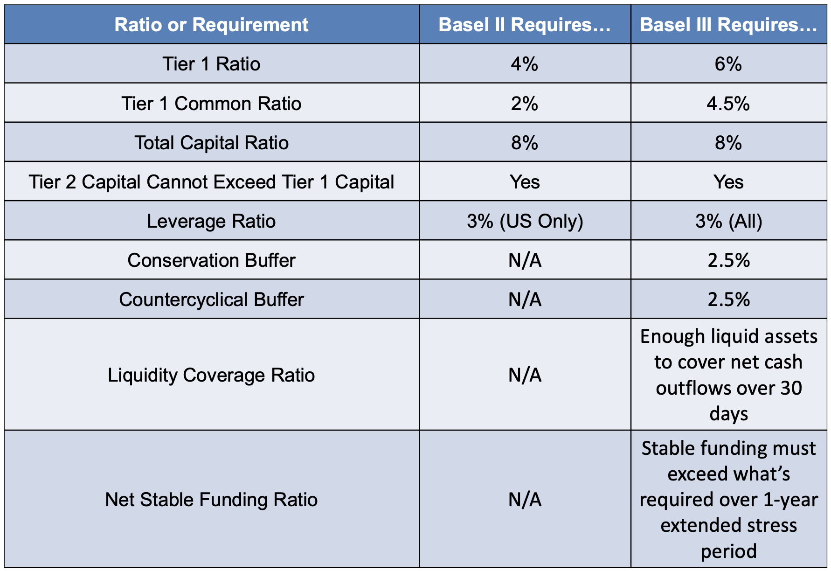
Basel III Capital Requirements
(1)
(1) The Conversion Buffer adds 2.5% to each of these numbers

Slide 17
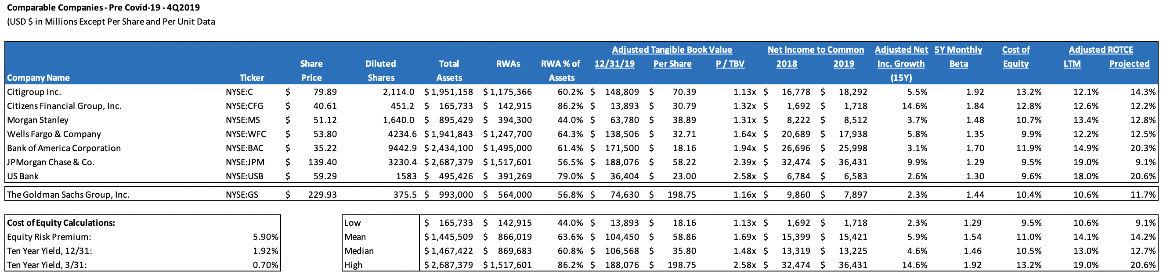
Comparable Companies – Prior to Covid-19

Slide 18
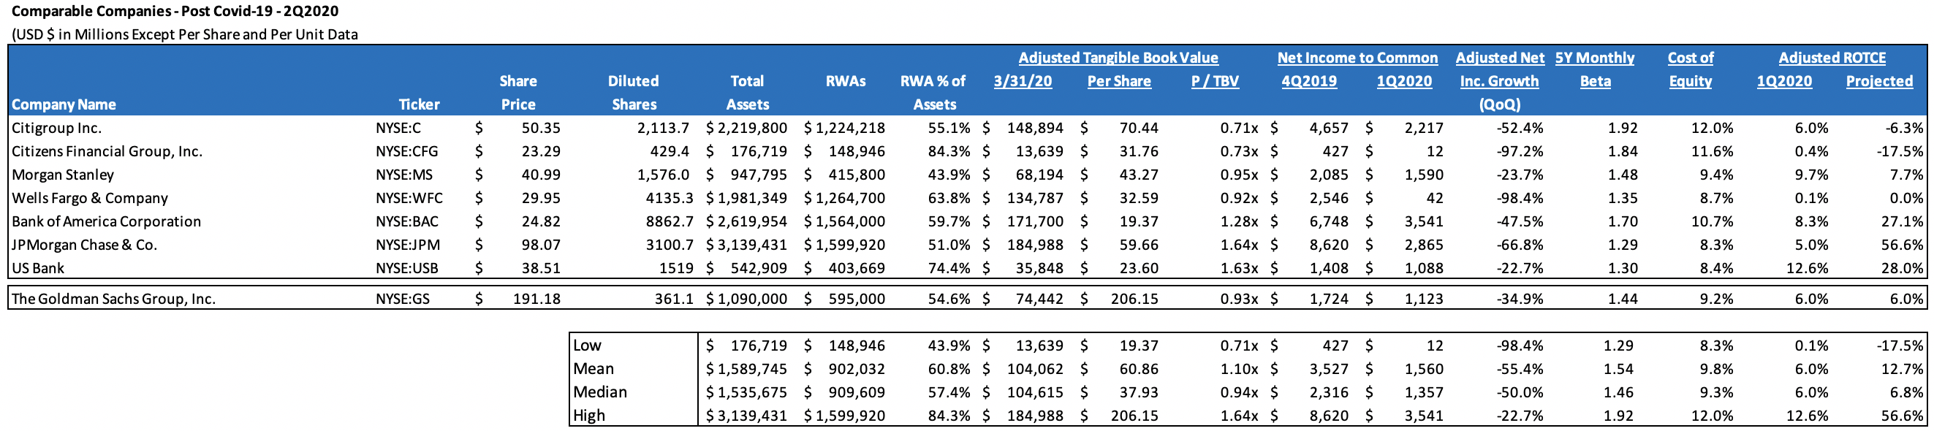
Comparable Companies – Post Covid-19

Slide 19
Yield Curve, 4/28/2020

Slide 20
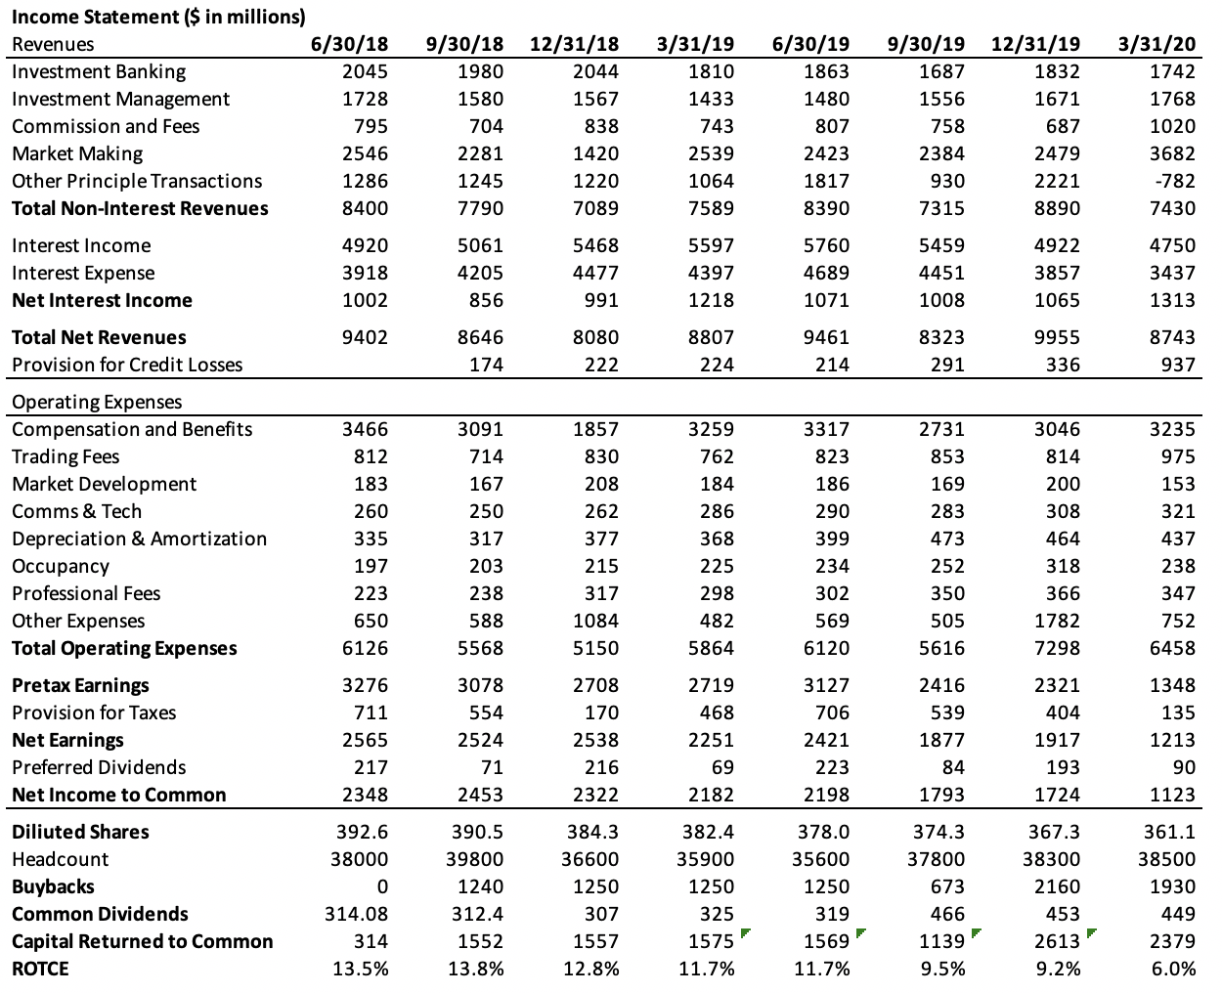
Simplified Income Statement

Slide 21
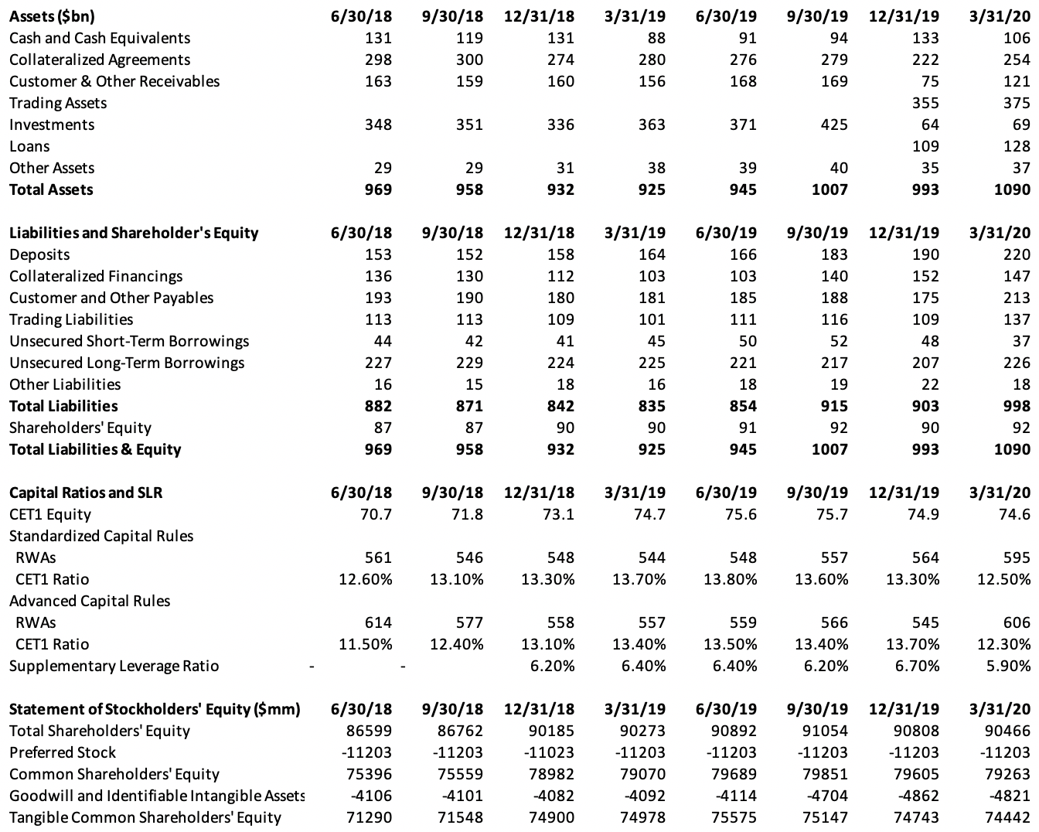
Simplified Balance Sheet

Slide 22
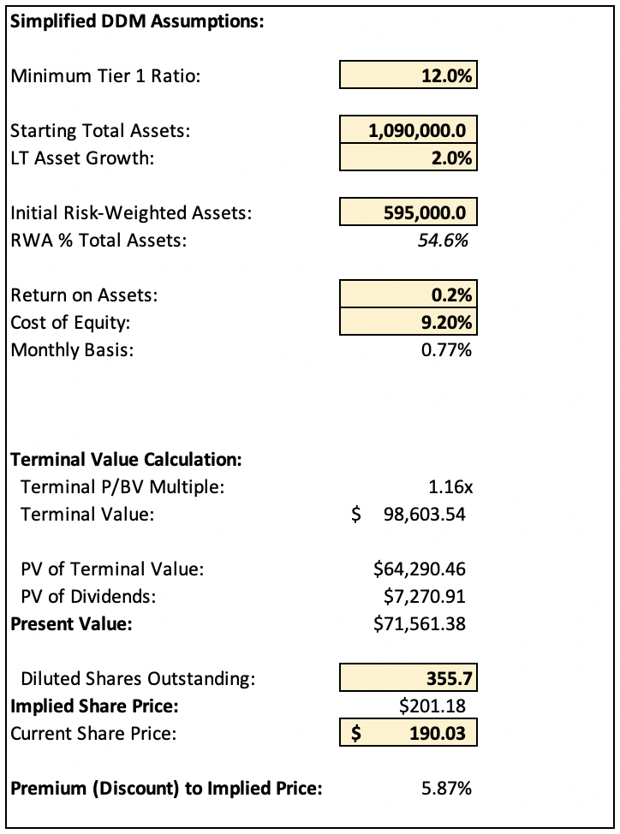
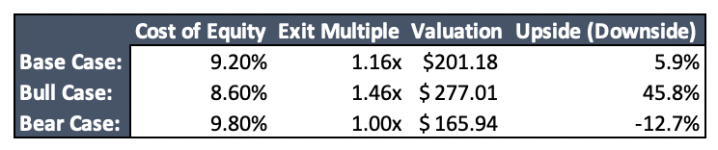
Valuation and Cases

