Slide 1
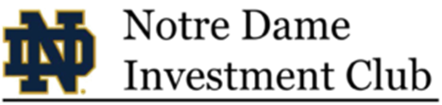
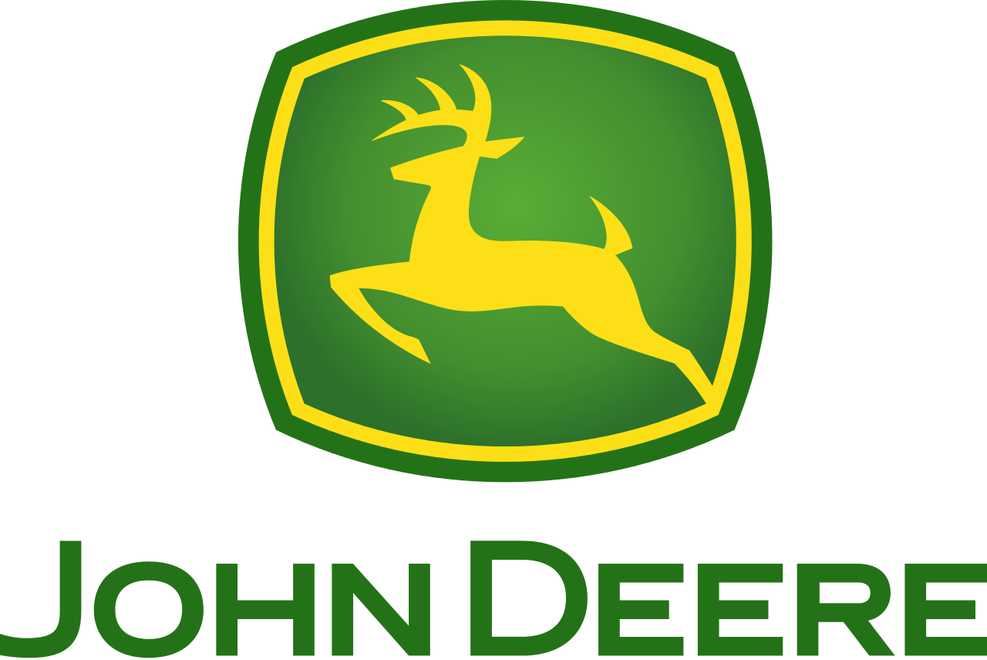
Deere and Company
NYSE: DE
Recommendation: BUY
Sean Keller & Grant Worthington

Slide 2
Investment Thesis
Recommendation:
Deere and Company (NYSE: DE) is undervalued in the market with long-term upside, therefore we recommend a buy – bottoming out in the last 3 years of demand for agricultural machinery along with a severe downturn in the agricultural economy make John Deere’s current price attractive
Rationale:
John Deere’s strong brand and durable business model along with their continual investment in the technological future of farming complement their existing strengths and will drive growth in the future
1
Dominant agriculture machine brand with economic moat
2
Will benefit from an equipment upgrade cycle and increasing crop demand
3
Solid core business to be enhanced by AI and data technology
Price Target: $190.25
25.8% upside to current price of $151.29

Slide 3
Company Overview
Company Profile
Historical Stock Chart
Deere & Company manufactures and distributes agriculture & turf, and construction & forestry equipment worldwide
The company has developed agricultural management systems using data collection and global satellite positioning technologies to enable farmers to control input costs and yields
John Deere competes with various companies across Agriculture and Turf & Construction and Forestry, but has no total direct competitors
John Deere is making a push to put data-driven analytical tools into the hands of farmers through automated farm vehicles, Farmsight system, and the acquisition of Blue River Tech.
Volume
2017 Revenue by Segment
Revenue Breakdown ($ in millions)
CAGR: -5.82%

Slide 4
Industry Overview
Overview
Agricultural Machinery Market Share
Farmer’s margins are greatly effected by crop prices, therefore industry revenue moves with crop prices
  Crop prices are expected to rebound over the next five years from their low current prices
  Demand for machinery is projected to increase closer to 2014 values
Technological improvements and investments in software are projected to increase demand for replacement machinery
As the world population continues to increase, efficient food production capabilities will be of utmost importance
Increased housing construction is projected to increase demand for construction machinery
Revenue vs Corn Prices ($ per bushel)
Industry Revenue Growth Rates

Slide 5
Dominant agricultural machine brand with economic moat
1
Overview
Brand Loyalty
John Deere is one of the most iconic American companies of all time dating back more than 175 years ago
One of Deere’s biggest competitive advantages is the relationships its independent dealers have with their customers
  Deere has amassed the largest network of independent dealers in the U.S. agricultural industry
Deere dominated the U.S. and Canada’s $23B farming equipment market with a 60% share
  Dealers essentially become partners with farmers which creates a multigenerational relationship
Demand for crops should continue rising over time as world population continues to grow
Farm Equipment survey of farmers
Are you brand loyal?
Loyal to John Deere?
Will benefit from an equipment update cycle and increasing crop demand
2
Equipment upgrade cycle
World Population Projections
The rising adoption of precision farming will lead farmers to replace old equipment
  Precision farming and spraying technology will allow farmers to maximize efficiency
There will be a noticeable trend in the market due to increasing demand for food owing to rising population
Demand for agricultural equipment bottomed out from 2015-17
  Demand has steadily increased in 2018, and will continue to normalize boosting John Deere’s revenue

Slide 6
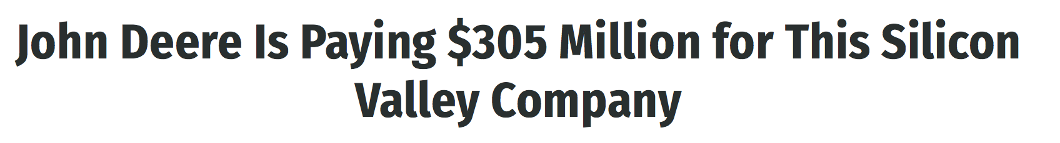
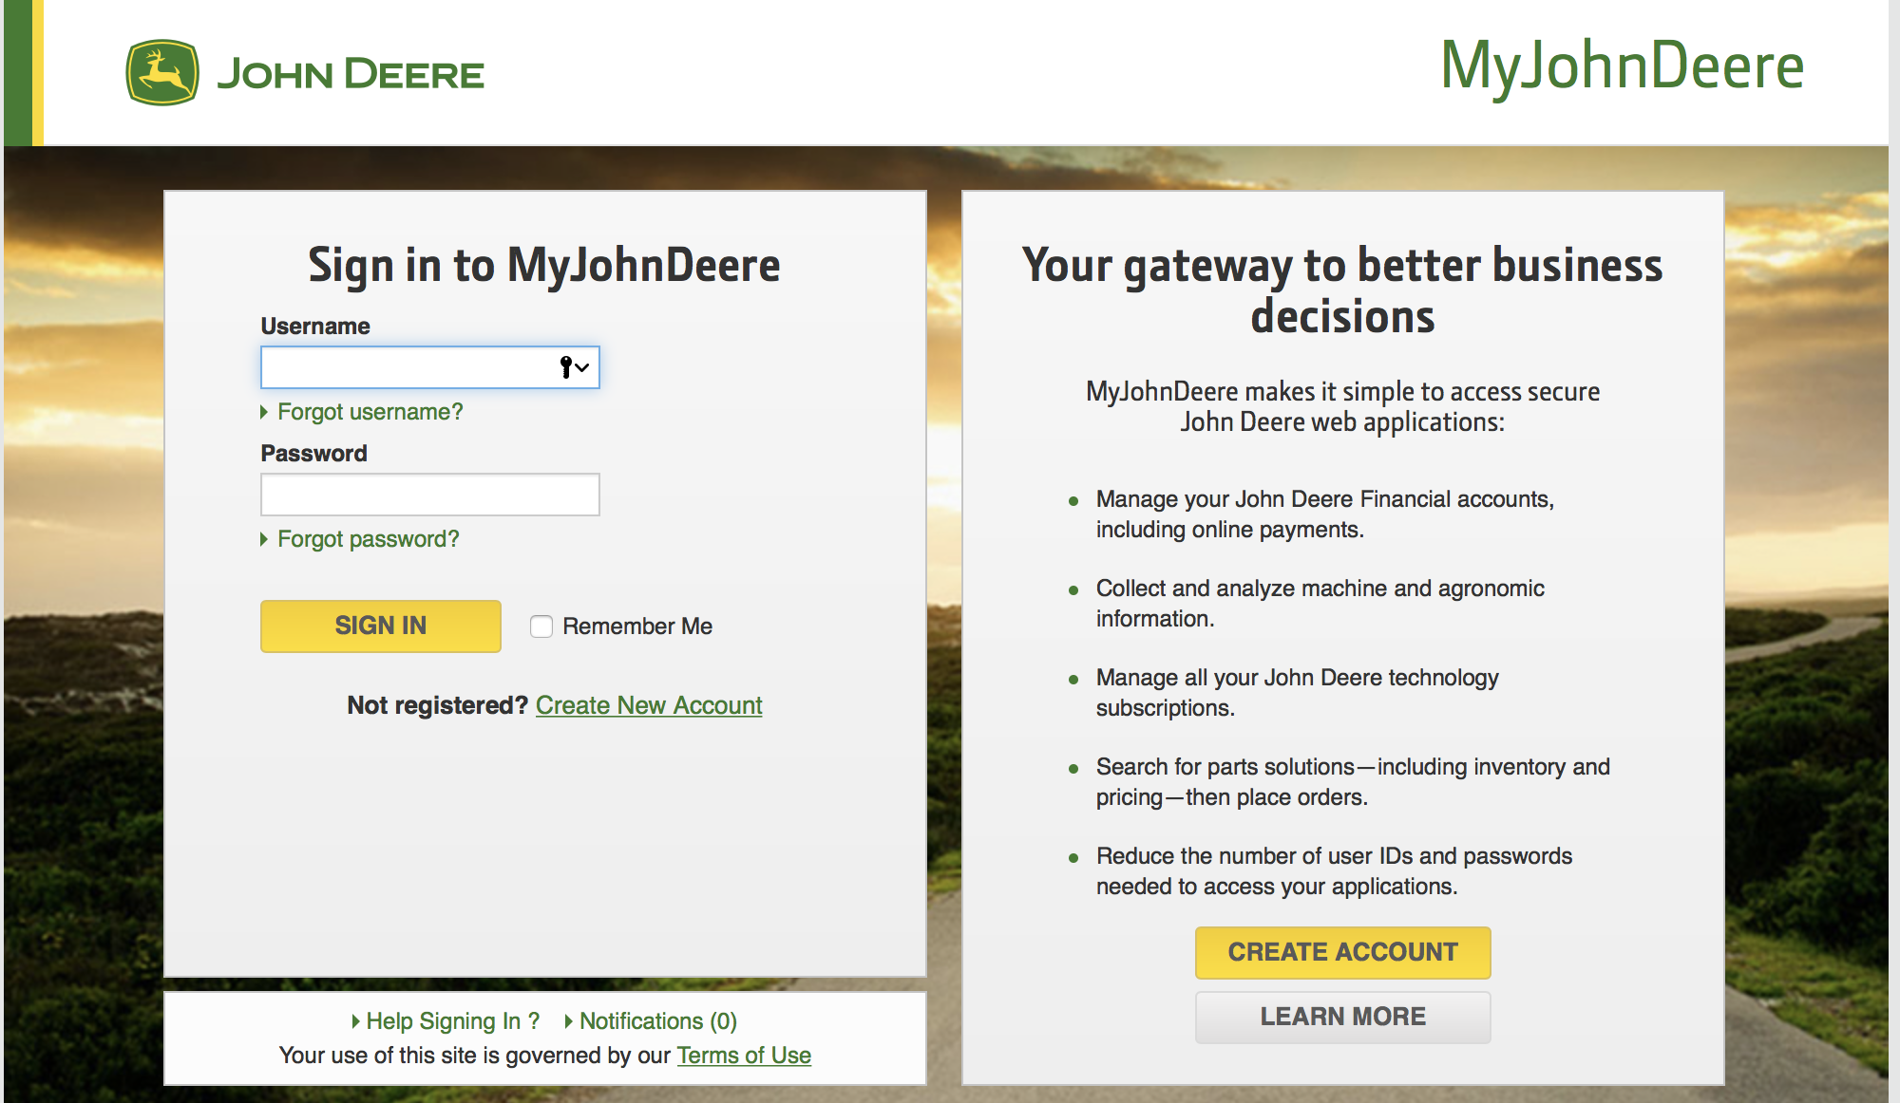
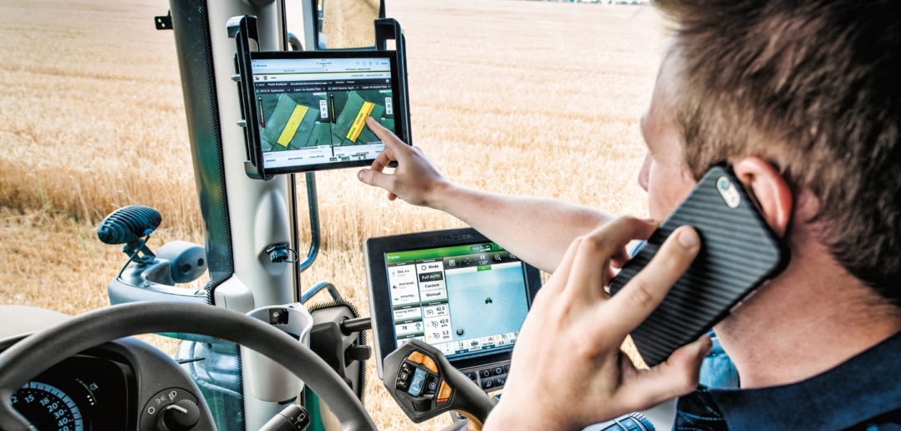
Solid core business to be enhanced by AI and data technology
3
Data Technology in Farming
John Deere acquired Blue River Technology (2017) to advance machine learning capabilities
Blue River Technology has successfully applied machine learning to agricultural sprays, and John Deere plans to apply this technology to other aspects of farming
As a leader in precision agriculture, John Deere recognizes the importance of AI for Deere’s future
Blue River Technology
The internet and Cloud Computing are expected to revolutionize the farming industry
1/3 of food produced is lost or wasted every year
  Much due to inefficiencies in planting, harvesting, water use, and trucking
The full scale adoption of precision farming tools could mean an increase in farm productivity unseen since mechanization
Field sensors and GPS units can provide data on soil conditions, wind, fertilizer requirements, water availability, pest infestation, and optimal equipment use
John Deere Farmsight Technology
John Deere has developed Farmsight technology which provides solutions for Machine Optimization, Logistics Optimization, and Decision Support
Notes:
The information is presented in the MyJohnDeere.com platform as well as on the iPad and iPhone app 'Mobile Farm Manager' in order to help farmers figure out what crops to plant where and when, when and where to plough, where the best return will be made with the crops and even which path to follow when ploughing. All this will increase the productivity and efficiency of the crops that in the end will lead to increased production and revenue.
MyJohnDeere.com platform. A portal where users can manager their fleet, see weather forecasts, access any application (including third party applications of third party machines) and view financial information related to their farming. Users have remote display access, so a consultant is able to see what is going on from a distance.

Slide 7
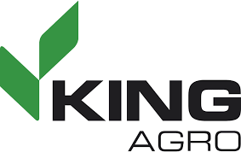

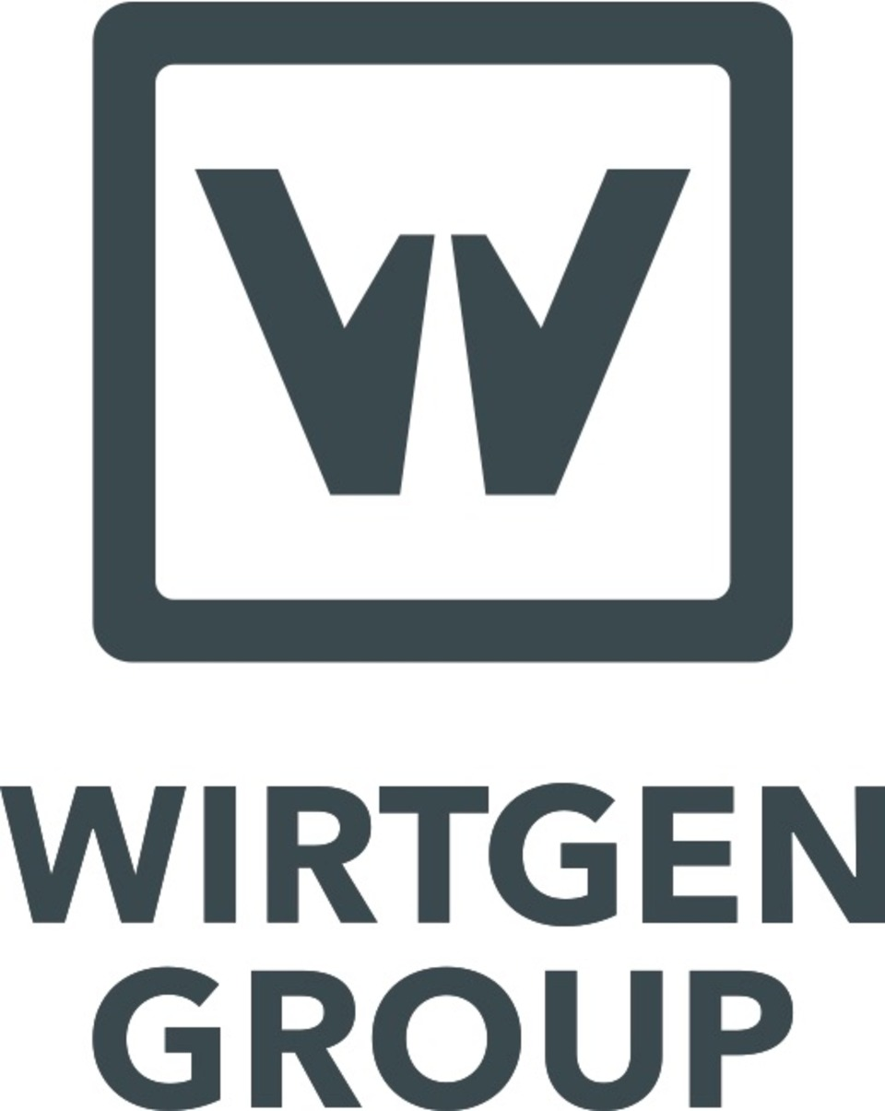
Recent Acquisitions
Company | Description | Benefit
 | Based in Spain. Creates precision molds and carbon fiber sprayers. Materials maximize strength to weight ratio. | Expands sprayer business and adopts cutting edge technology to boost quality.
 | Based in Argentina. Develops and distributes spraying and fertilizing equipment | Due to low crop prices, consolidation and economies of scale have been crucial to sustained revenues.
 | Based in Germany. Leading manufacturer worldwide of road construction, mixing, and paving equipment. | Has contributed to 12% of total revenue growth in 2018 and management expects continued growth.

Slide 8
Key Risks
Key Risks
Mitigants
International trade laws may limit ability to access raw materials and export their products
Adverse weather conditions
Changes to Engine Emission Standards
Negative economic conditions and outlook can materially weaken demand for John Deere’s equipment and services
Equipment operations and financial services segments are subject to interest rate risks. Changes in interest rates can reduce demand for equipment, increasing borrowing costs
Cyclical nature of agriculture industry
Booming growth for food in developing and emerging markets
Most of John Deere business is concentrated in the U.S.
Price Realization has been successful at combatting tariffs
Other operations besides agriculture can consolidate for agricultural down years
Technology will help adapt to changes in weather and provide best strategy
Longtime established relationships between dealers/brand and farmers to provide lasting business for generations
During years with low crop prices, John Deere’s leasing revenue increases; John Deere’s other segments can also compensate for agricultural underperformance

Slide 9
Final Recommendation
Downside Case
Price Target: $99.42
Upside: (34.3%)
Base Case
Price Target: $190.25
Upside: 25.8%
Upside Case
Price Target: $235.30
Upside: 55.5%
Recommendation:
John Deere (NYSE:DE) has a sticky consumer base, is well positioned in the booming data farming industry, and will benefit from recovering crop prices and demand for machinery. We recommend a buy.

Slide 10

Appendix

Slide 11
Valuation – Comparable Companies Analysis

Slide 12
Valuation – WACC

Slide 13
Valuation – DCF (Base)

Slide 14
Valuation – DCF (Base)

Slide 15
Valuation – DCF (Upside)

Slide 16
Valuation – DCF (Upside)

Slide 17
Valuation – DCF (Downside)

Slide 18
Valuation – DCF (Downside)

