Slide 1
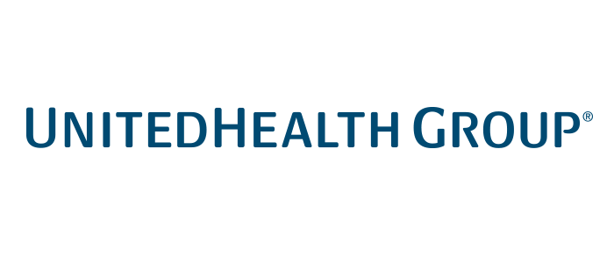
UnitedHealth Group, Inc.
NYSE: UNH
Recommendation: BUY
Spencer Buzdon & Noel Vincent

Slide 2
Investment Thesis
Recommendation:
UnitedHealth Group (NYSE: UNH) shows strong growth, with investors continuing to value UNH as an insurance group rather than applying rationale given to consulting firms, leading to a market lagging in recognizing value.
Rationale: UnitedHealth Group is a cornerstone of the insurance industry, generating consistent and growing revenues as the top player in the market. Additionally, a strong strategic entrance into the digital health market allows the firm to leverage trends in big data and machine based learning. Lastly, while their Optum segment grows, the market continues to value UNH as an insurance firm and thereby fails to capture its value.
1
A cornerstone of the insurance industry, generating consistent, growing revenues as the top player in the market
2
While their Optum segment grows, the market continues to value UNH as an insurance firm and thereby fails to capture its value.
3
Strong strategic entrance in to the digital health market allows firm to leverage trends in big data and machine based learning
Price Target: $318.68
17.64% upside to current price of $270.90
Notes:
Optum is continuing to show double digit growth as UNH enters consulting, pharmacy management & health care solutions.

Slide 3
Company Overview
Company Profile
Historical Stock Chart
UnitedHealth Group Inc. owns and manages health systems & employee benefit programs. UnitedHealth also provides specialized care services, health care information and research
Four main segments: UnitedHealthcare, OptumHealth, OptumInsight, and OptumRx
The Company is the fifth largest by revenue in the US and UnitedHealthcare is the largest health insurance provider in the world
The Company’s Optum units focus on health services including health & wellness, technology & consulting, and pharmacy management
The Optum line of services resulted from the merging of several UnitedHealth businesses in 2007
2017 Revenue by Segment
Revenue Breakdown ($ in millions)
CAGR: 13.83%
Notes:
EBITDA Margin drop from 2013 to 2014: (2014-10K) "The increase in our operating cost ratio during the year ended December 31, 2014 was due to the introduction of ACA Fees and services business growth and acquisitions, partially offset by productivity and operating performance gains.“ The affordable care act has cut into EBITDA margins since then and productivity and performance gains have offset those losses over the past 2 years.

Slide 4
Segment Overview
UnitedHealthcare
OptumHealth
The core health benefits segment, accounts for about 65% of annual revenues
Manages health maintenance organization (HMO) preferred provider organization (PPO), and point-of-service (POS) plans, as well as Medicare, Medicaid, state-funded, and supplemental vision and dental options
Largest division is the Employer & Individual unit, which serves about 30 million members through its plans for students, families, individuals, and businesses (ranging from sole proprietorships to multinational enterprises)
Accounts for about 10% of revenue growth
Provides personalized wellness, employee assistance, onsite screening, and others to encourage consumers to actively participate in managing their health & seek preventive care
OptumInsight
OptumRx
Accounts for around 3% of revenue
Develops software and information products and provides advisory consulting service and business process outsourcing to participants in the health care industry
Serves hospitals, physicians, commercial health plans, government agencies, life sciences companies, that comprise the health care system to reduce costs, meet compliance mandates, improve clinical performance
Accounts for about a quarter of total revenues
A pharmacy benefit management (PBM) company that processes hundreds of millions of drug prescriptions annually and manages billions of dollars' worth of pharmaceutical spending each year
Network includes more than 67,000 retail pharmacies and a number of home delivery facilities throughout the US.
Notes:
UnitedHealthcare, the core health benefits segment, is king, accounting for about 65% of annual revenues. Its largest business is the Employer & Individual unit, which serves about 30 million members through its plans for students, families, individuals, and businesses (ranging from sole proprietorships to multinational enterprises). The Medicare & Retirement senior services unit is the second-largest business. A smaller division, Community & State, manages public Medicaid programs for disabled and disadvantaged citizens. Military & Veterans provides medical plans for about 3 million active and retired military personnel and their families in the western US through a government TRICARE contract. Finally, the Global unit serves international markets and includes Amil, which provides health and dental benefits to some 6 million people in Brazil.
Other divisions, in order by value: Medicare & Retirement, Community & State, Military & Veterans, and Global
Combined provider network of approx. 1 million doctors
UnitedHealth has also reshaped its OptumInsight business around the booming data management needs of US health providers.
Including 26,000 practicing technologists, data scientists, actuaries and clinicians, work toward providing providers with the tools they need to evolve with the health system
HIMMS18 announcement to implement machine-based learning (Artificial Intelligence)

Slide 5
Industry Overview
Overview of the Managed Care Industry
Market Share (Revenue)
Low Medical Costs
Medical costs are expected to remain below health insurer outlooks throughout the year
Adverse effect of strong flu season offset by low medical costs, outperformed S&P by 500bp through June 15
Declining Inpatient Visits
Medicare removed an inpatient-only restriction that has begun moving procedures out of the hospital
Medicare Ratings
UNH expected to lead industry in Medicare Advantage star ratings; correlated with enrollment growth
2013
2017
Health Insurance Industry Revenue ($, billions)
Healthcare Consulting Industry Revenue ($, billions)
CAGR: 4.78%
CAGR: 1.12%
CAGR: 6.07%
CAGR: 5.84%
Notes:
Flu season: Cyclic nature of Influenza-Like Illness as a % of total outpatient visits
Declining Inpatients: Medicare decision results in 20% of knee replacements moving to outpatients\

Slide 6
Cornerstone of Insurance
1
Overview
Historical Healthcare Services Revenue (billions)
Healthcare services make up the largest portion of revenues
Insurance segment, one of the biggest in the nation
Healthcare is relatively steady, UNH has a beta of 0.73 making it resistant to market movements
Even during the 2008 crisis, UNH increased revenues YOY
UNH shows a strong ability to increase revenues, with 10% growth rates despite such a large market capitalization
As consumers take more accountability for their health and popularity of programs like Optum rise, expenses will fall and margins in UNH’s insurance segment will rise accordingly
CAGR: 10.00%
CAGR: 10.87%
2
Growth in Non-Insurance Healthcare
Optum as a Differentiator
Growth of Optum Revenue ($ Millions)
A “distinct” yet “complementary” business
In the second quarter 2018, OptumHealth increased the number of people it serves by 7%
OptumInsight's backlog grew nearly 15% year-over-year on account of its technology data analytics, business process, and advisory services
OptumRx again filled over 3% more adjusted prescriptions as it continued to expand its market share
OptumInsights performance analytics are now used in nearly one third of the total healthcare services performs in the US
CAGR: 19.06%

Slide 7
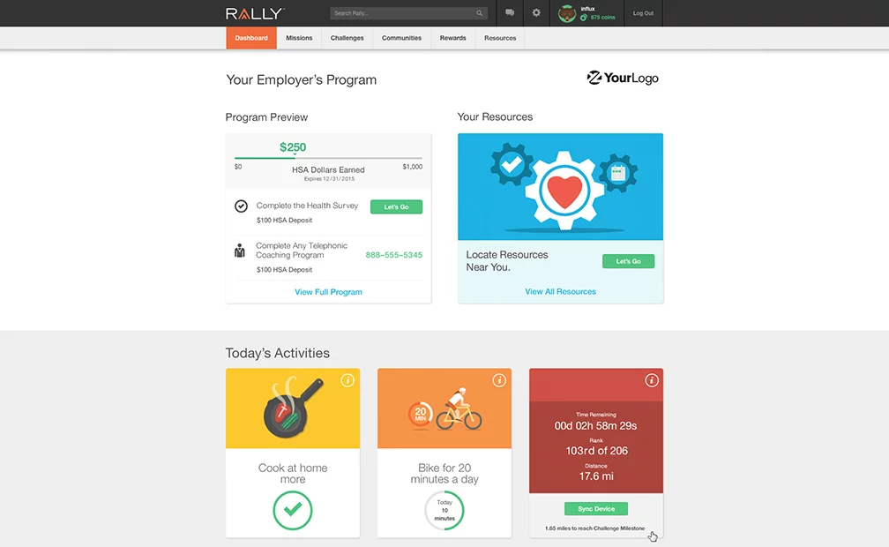
Strategic Entrance to Digital Health
3
The Digital Health Market
Global Digital Health Market ($ Billions)
Allows consumers to visualize their healthcare plans, understand benefits, view biometrics, etc.
UNH acquired Rally and is now able to engage directly with consumers to help increase quality of life
US Digital Health Market is expected to witness more than 26% CAGR from 2017 through 2024
Over the past 4 years, Rally has paid over out over $1bn to consumers in incentives for being healthy
CAGR: 21.13%
Direct-to-Consumer Service Breakdown
Rally’s Consumer Facing Interface
Tailor-made for employers
Point system to incentivize staying healthy
Ability to book and manage appointments/procedures within interface
Recommended “Today’s Activities” to support a healthy lifestyle
Healthier client base intuitively reduces costs to insurance providers

Slide 8
Key Risks
Key Risks
Mitigants
Failing to effectively project medical costs and price insurance plans
Government reform for healthcare is frequent and unpredictable
The health care industry continues to be a target of sophisticated cybersecurity attacks.
Almost half a century of experience and has grown into one of the largest healthcare companies in the world
Health plans and employers continue to award OptumRx new business
Existing customers are retained at a high 90s percentage rate, YOY
Over 500 dedicated resources, 24X7X365 Cyber Forensic & Security Incident Response Command Center, monitoring over a trillion events annually
Recent Acquisitions
 | Genoa Healthcare | Advisory Board | Surgical Care Affiliates | Catamaran Corp | DaVita
Description | Pharm. leader in behavioral health and addiction | Leading in strategic industry leading research | Surgery management services for hospitals and ASCs | Fourth largest pharmacy-benefit manager in US | Operates 300 clinics and 6 outpatient surgical centers
Incentive | Allows OptumRx to serve more diverse patients | Allows OptumInsight to enhance overall research potential | Allows Optum to enhance services geared to surgery | Increases OptumRx’s market share and customer base | Facilities to become part of Optum-Health services

Slide 9
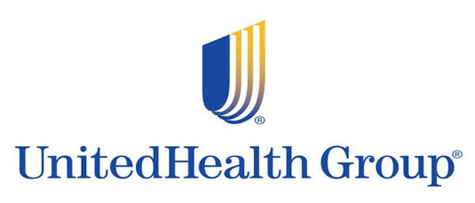
Final Recommendation
Downside Case
Price Target: $250.85
Downside: (7.40)%
Base Case
Price Target: $318.68
Upside: 17.64%
Upside Case
Price Target: $369.36
Upside: 36.35%
Recommendation:
UnitedHealth Group (NYSE: UNH) is valued as an insurance firm despite a strong move into consulting, causing the market to miss UnitedHealth Group’s value.

Slide 10
Appendix

Slide 11
Valuation – Comparable Companies Analysis

Slide 12
Valuation – WACC

Slide 13
Valuation – DCF (Base)

Slide 14
Valuation – DCF (Upside)

Slide 15
Valuation – DCF (Downside)

